Slide 1
4: Distributed Special Purpose Systems
(Continued)

Slide 2
Stateful and Stateless Service
There are two approaches for storing server-side information when a client accesses remote files:
either the server tracks each file being accessed by each client,
or it simply provides blocks as they are requested by the client without knowledge of how those blocks are used.
In the former case, the service provided is stateful; in the latter case, it is stateless.

Slide 3
Stateful File Service
The typical scenario involving is as follows:
A client must perform an open () operation on a file before accessing that file.
The server fetches information about the file from its disk, stores it in its memory, and gives the client a connection identifier that is unique to the client and the open file. (In UNIX terms, the server fetches the inode and gives the client a file descriptor, which serves as an index to an in-core table of inodes.)
This identifier is used for subsequent accesses until the session ends.
A stateful service is characterized as a connection between the client and the server during a session.
Either on closing the file or through a garbage-collection mechanism, the server must reclaim the main-memory space used by clients that are no longer active.
The key point regarding fault tolerance in a stateful service approach is that the server keeps main-memory information about its clients.
AFS (Andrew File System) is a stateful file service.

Slide 4
Stateless File System
It avoids state information by making each request self-contained.
That is, each request identifies the file and the position in them file (for read and write accesses) in full.
The server does not need to keep a table of open files in main memory, although it usually does so for efficiency reasons.
Moreover, there is no need to establish and terminate a connection through open() and close() operations.
They are totally redundant since each file operation stands on its own and is not considered part of a session.
A client process would open a file, and that open would not result in the sending of a remote message.
Reads and writes would take place as remote messages (or cache lookups).
The final close by the client would again result in only a local operation. NFS is a stateless file service.

Slide 5
File Replication
Replication of files on different machines in a distributed file system is a useful redundancy for improving availability.
Multimachine replication can benefit performance too: selecting a nearby replica to serve an access request results in shorter service time.
The basic requirement of a replication scheme is that different replicas of the same file reside on failure-independent machines.
That is, the availability of one replica is not affected by the availability of the rest of the replicas.
This obvious requirement implies that replication management is inherently a location-opaque activity.
Provisions for placing a replica on a particular machine must be available.

Slide 6
`
It is desirable to hide the details of replication from users.
Mapping a replicated file name to a particular replica is the task of the naming scheme.
The existence of replicas should be invisible to higher levels.
At lower levels, however, the replicas must be distinguished from one another by different lower-level names. Another transparency requirement is providing replication control at higher levels.
Replication control includes determination of the degree of replication and of the placement of replicas.
Under certain circumstances, we may want to expose these details to users.
Locus, for instance, provides users and system administrators with mechanisms to control the replication scheme.

Slide 7
The main problem associated with replicas is updating.
From a user's point of view, replicas of a file denote the same logical entity, and thus an update to any replica must be reflected on all other replicas.
More precisely, the relevant consistency semantics must be preserved when accesses to replicas are viewed as virtual accesses to the replicas' logical files.
If consistency is not of primary importance, it can be sacrificed for availability and performance.
In this fundamental trade off in the area of fault tolerance, the choice is between preserving consistency at all costs, thereby creating a potential for indefinite blocking, and sacrificing consistency under some (we hope, rare) circumstances for the sake of guaranteed progress.
Locus, for example, employs replication extensively and sacrifices consistency in the case of network partition for the sake of availability of files for read and write accesses.

Slide 8
4.2: Real Time System
A real-time system is a computer system that requires not only that the computing results be "correct" but also that the results be produced within a specified deadline period.
Results produced after the deadline has passed - even if correct-may be of no real value.
To illustrate, consider an autonomous robot that delivers mail in an office complex.
If its vision-control system identifies a wall after the robot has walked into it, despite correctly identifying the wall, the system has not met its requirement.
Contrast this timing requirement with the much less strict demands of other systems. In an interactive desktop computer system, it is desirable to provide a quick response time to the interactive user, but it is not mandatory to do so.
Some systems -such as a batch-processing system-may have no timing requirements whatsoever.

Slide 9
Real-time systems executing on traditional computer hardware are used in a wide range of applications.
In addition, many real-time systems are embedded in "specialized devices," such as ordinary home appliances (for example, microwave ovens and dishwashers), consumer digital devices (for example, cameras and MP3 players), and communication devices (for example, cellular telephones and Blackberry handheld devices).
They are also present in larger entities, such as automobiles and airplanes.
An embedded system is a computing device that is part of a larger system in which the presence of a computing device is often not obvious to the user.

Slide 10
Some real-time systems are identified as safety-critical systems.
In a safety-critical system, incorrect operation-usually due to a missed deadline -results in some sort of “catastrophe”.
Real-time computing is of two types: hard and soft.
A hard real-time system has the most stringent requirements, guaranteeing that critical realtime tasks be completed within their deadlines.
Safety-critical systems are typically hard real-time systems.
A soft real-time system is less restrictive, simply providing that a critical real-time task will receive priority over other tasks and that it will retain that priority until it completes.
Many commercial operating systems - as well as Linux -provide soft real-time support.

Slide 11
System Characteristics
We explore the characteristics of real-time systems and address issues related to designing both soft and hard real-time operating systems.
The following characteristics are typical of many real-time systems:
Single purpose
Small size
Inexpensively mass-produced
Specific timing requirements

Slide 12
1. Single Purpose
Unlike PCs, which are put to many uses, a real-time system typically serves only a single purpose, such as controlling antilock brakes or delivering music on an MP3 player.
It is unlikely that a real-time system controlling an airliner's navigation system will also play DVDs!
The design of a real-time operating system reflects its single-purpose nature and is often quite simple.

Slide 13
2. Small Size
Many real-time systems exist in environments where physical space is constrained.
Consider the amount of space available in a wristwatch or a microwave oven-it is considerably less than what is available in a desktop computer.
As a result of space constraints, most real-time systems lack both the CPU processing power and the amount of memory available in standard desktop PCs.
Whereas most contemporary desktop and server systems use 32- or 64-bit processors, many real-time systems run on 8- or 16-bit processors.
Similarly, a desktop PC might have several gigabytes of physical memory, whereas a real-time system might have less than a megabyte.
We refer to the amount of memory required to run the operating system and its applications as the footprint of a system. Because the amount of memory is limited, most real-time operating systems must have small footprints.

Slide 14
3. Inexpensively mass-produced
Next, consider where many real-time systems are implemented: they are often found in home appliances and consumer devices.
Devices such as digital cameras, microwave ovens, and thermostats are mass-produced in very cost-conscious environments.
Thus, the microprocessors for real-time systems must also be inexpensively mass-produced.

Slide 15
4. Specific timing requirements
It is, in fact, the defining characteristic of such systems.
Accordingly, the primary task of both hard and soft real-time operating systems is to support the timing requirements of real-time tasks.
Real-time operating systems meet timing requirements by using scheduling algorithms that give real-time processes the highest scheduling priorities.
Furthermore, schedulers must ensure that the priority of a real-time task does not degrade over time.
Another technique for addressing timing requirements is by minimizing the response time to events such as interrupts.

Slide 16
Features of Real Time Kernels
We begin by examining several features provided in many of the operating systems discussed so far in this subjects.
These systems typically provide support for the following:
A variety of peripheral devices, such as graphical displays, CD drives, and DVD drives
Protection and security mechanisms
Multiple users
Supporting these features often results in a sophisticated - and large - kernel.
For example, Windows XP has over forty million lines of source code.
In contrast, a typical real-time operating system usually has a very simple design, often written in thousands rather than millions of lines of source code.
We would not expect these simple systems to include the features listed above.

Slide 17
But why don't real-time systems provide these features, which are crucial to standard desktop and server systems?
There are several reasons, but three are most prominent.
First, because most real-time systems serve a single purpose, they simply do not require many of the features found in a desktop PC.
Consider a digital wristwatch: it obviously has no need to support a disk drive or DVD, let alone virtual memory.
Furthermore, a typical real-time system does not include the notion of a user.
The system simply supports a small number of tasks, which often await input from hardware devices (sensors, vision identification, and so forth).

Slide 18
Second, the features supported by standard desktop operating systems are impossible to provide without fast processors and large amounts of memory.
Both of these are unavailable in real-time systems due to space constraints, as explained earlier.
In addition, many real time systems lack sufficient space to support peripheral disk drives or graphical displays, although some systems may support file systems using nonvolatile memory (NVRAM).

Slide 19
Third, supporting features common in standard desktop computing environments would greatly increase the cost of real-time systems, which could make such systems economically impractical.
Additional considerations arise when we consider virtual memory in a real-time system.
Providing virtual memory features as described earlier requires that the system include a memory-management unit (MMU) for translating logical to physical addresses.
However, MMUs typically increase the cost and power consumption of the system.
In addition, the time required to translate logical addresses to physical addresses - especially in the case of a translation look-aside buffer (TLB) miss - may be prohibitive in a hard real-time environment.

Slide 20
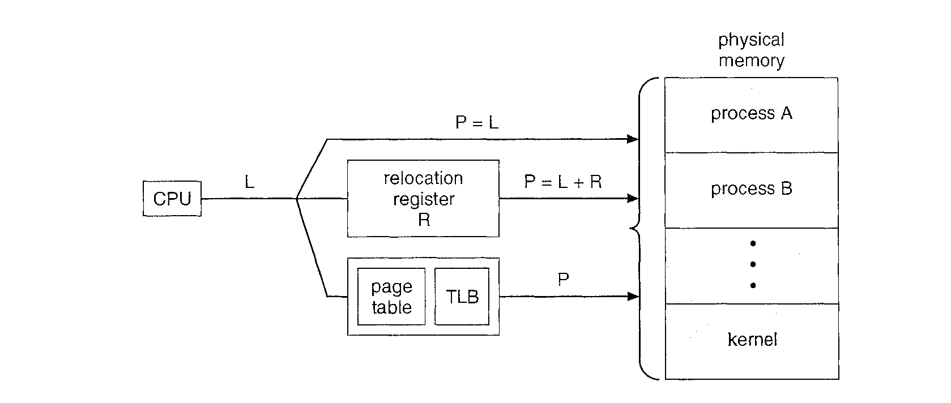
Several approaches for translating addresses in real-time systems

Slide 21
The first approach is to bypass logical addresses and have the CPU generate physical addresses directly.
This technique - known as real-addressing mode-does not employ virtual memory techniques and is effectively stating that P equals L.
One problem with real-addressing mode is the absence of memory protection between processes.
Real-addressing mode may also require that programmers specify the physical location where their programs are loaded into memory.
However, the benefit of this approach is that the system is quite fast, as no time is spent on address translation.
Real-addressing mode is quite common in embedded systems with hard real-time constraints.
In fact, some real-time operating systems running on microprocessors containing an MMU actually disable the MMU to gain the performance benefit of referencing physical addresses directly.

Slide 22
A second strategy for translating addresses is to use an approach similar to the dynamic relocation register.
In this scenario, a relocation register R is set to the memory location where a program is loaded.
The physical address P is generated by adding the contents of the relocation register R to L.
Some real-time systems configure the MMU to perform this way.
The obvious benefit of this strategy is that the MMU can easily translate logical addresses to physical addresses using P = L + R.
However, this system still suffers from a lack of memory protection between processes.

Slide 23
The last approach is for the real-time system to provide full virtual memory functionality.
In this instance, address translation takes place via page tables and a translation look-aside buffer, or TLB.
In addition to allowing a program to be loaded at any memory location, this strategy also provides memory protection between processes.
For systems without attached disk drives, demand paging and swapping may not be possible.
However, systems may provide such features using NVRAM flash memory.
The LynxOS and On Core Systems are examples of real-time operating systems providing full support for virtual memory.

Slide 24
Implementing RTOS
Keeping in mind the many possible variations, we now identify the features necessary for implementing a real-time operating system.
This list is by no means absolute; some systems provide more features than we list below, while other systems provide fewer.
Preemptive, priority-based scheduling
Preemptive kernel
Minimized latency
One notable feature we omit from this list is networking support.

Slide 25
1. Priority-Based Scheduling
The most important feature of a real-time operating system is to respond immediately to a real-time process as soon as that process requires the CPU.
As a result, the scheduler for a real-time operating system must support a priority-based algorithm with preemption.
Recall that priority-based scheduling algorithms assign each process a priority based on its importance; more important tasks are assigned higher priorities than those deemed less important.
If the scheduler also supports preemption, a process currently running on the CPU will be preempted if a higher-priority process becomes available to run.

Slide 26
2. Preemptive Kernels
To meet the timing requirements of real-time systems-in particular, hard real-time systems-preemptive kernels are mandatory.
Otherwise, a real-time task might have to wait an arbitrarily long period of time while another task was active in the kernel.
There are various strategies for making a kernel preemptible.
One approach is to insert preemption points in long-duration system calls.
A preemption point checks to see whether a high-priority process needs to be run. If so, a context switch takes place.
Then, when the high-priority process terminates, the interrupted process continues with the system call. Preemption points can be placed only at safe locations in the kernel-that is, only where kernel data structures are not being modified.
A second strategy for making a kernel preemptible is through the use of synchronization mechanisms, discussed earlier.
With this method, the kernel can always be preemptible, because any kernel data being updated are protected from modification by the high-priority process.

Slide 27
3. Minimizing Latency
Consider the event-driven nature of a real-time system.
The system is typically waiting for an event in real time to occur.
Events may arise either in software -as when a timer expires-or in hardware-as when a remote-controlled vehicle detects that it is approaching an obstruction.
When an event occurs, the system must respond to and service it as quickly as possible.
We refer to event latency as the amount of time that elapses from when an event occurs to when it is serviced.

Slide 28
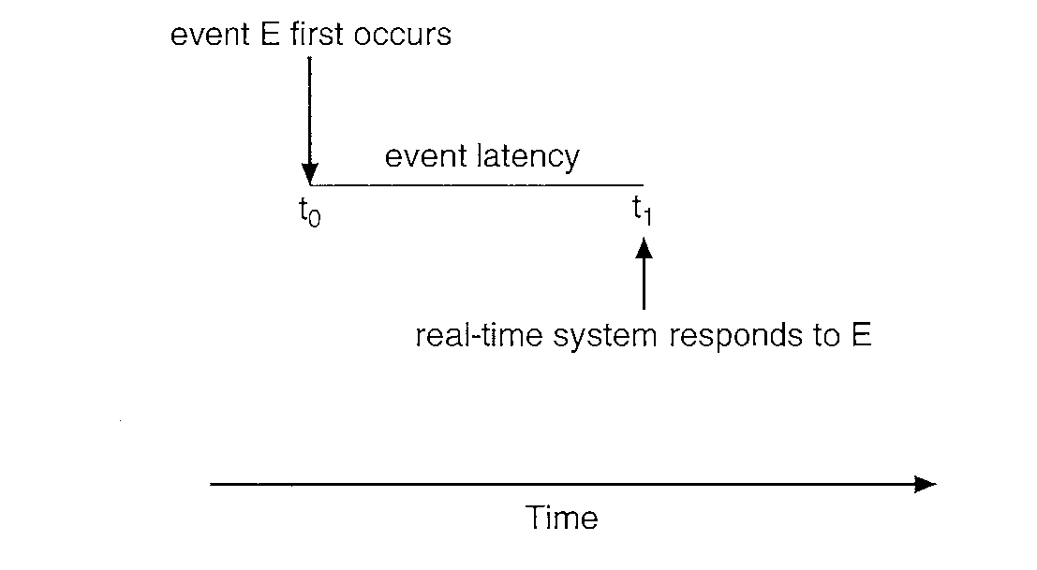
Two types of latencies affect the performance of real-time systems:
Interrupt latency
Dispatch latency

Slide 29
Interrupt latency
Interrupt latency refers to the period of time from the arrival of an interrupt at the CPU to the start of the routine that services the interrupt.
When an interrupt occurs, the operating system must first complete the instruction it is executing and determine the type of interrupt that occurred.
It must then save the state of the current process before servicing the interrupt using the specific interrupt service routine (ISR).
The total time required to perform these tasks is the interrupt latency.

Slide 30
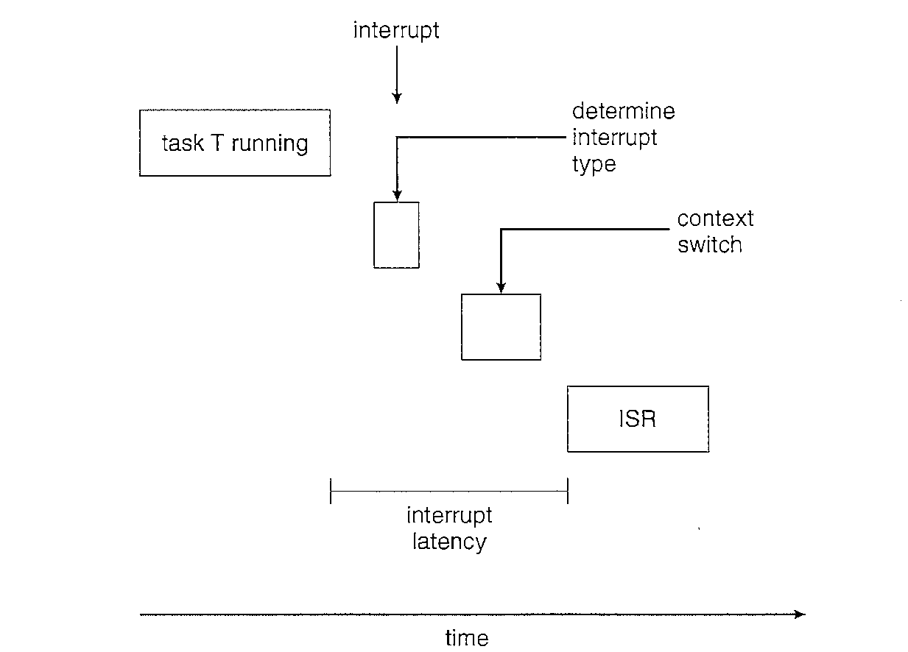

Slide 31
Dispatch latency
The amount of time required for the scheduling dispatcher to stop one process and start another is known as dispatch latency.
Providing real-time tasks with immediate access to the CPU mandates that real-time operating systems minimize this latency.
The most effective technique for keeping dispatch latency low is to provide preemptive kernels.
In Figure , we diagram the makeup of dispatch latency.
The conflict phase of dispatch latency has two components:
Preemption of any process running in the kernel
Release by low-priority processes of resources needed by a high-priority process

Slide 32
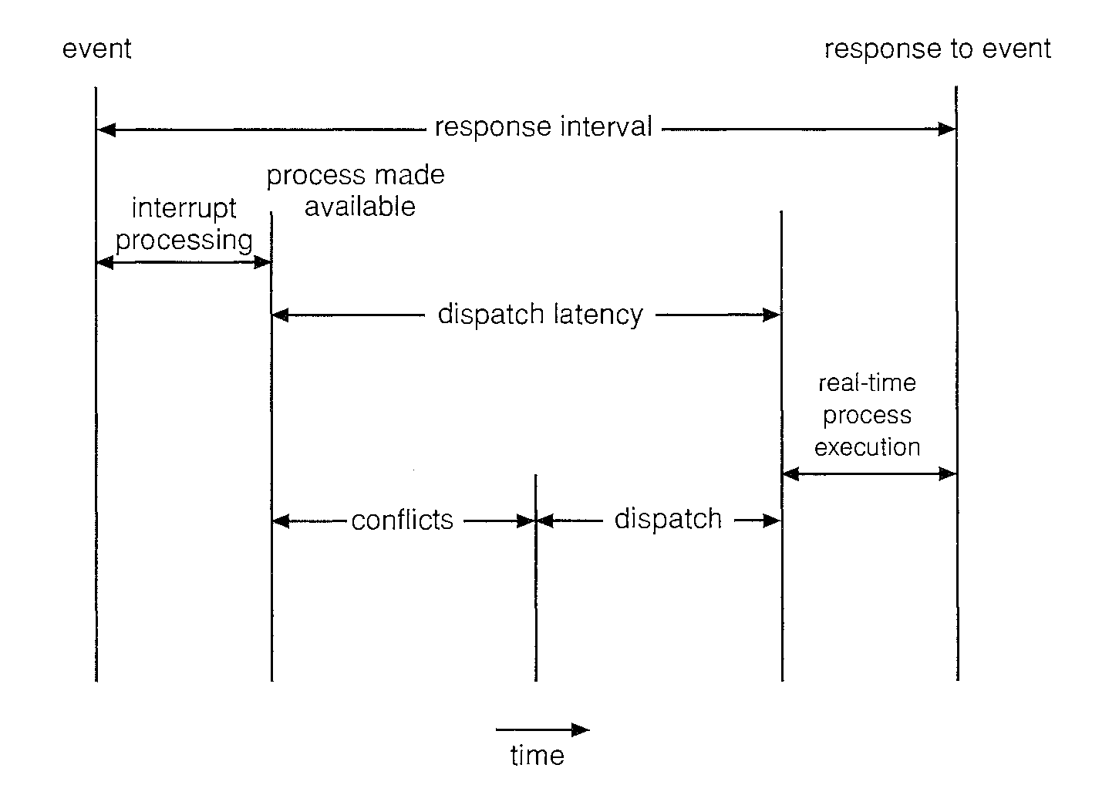

Slide 33
Real Time CPU Scheduling
Rate-Monotonic Scheduling
Earliest-Deadline-First Scheduling
Proportional Share Scheduling
Pthread Scheduling
Will be given as Assignment!!!

Slide 34
Multimedia System
The term multimedia describes a wide range of applications that include audio and video files such as MP3 audio files, DVD movies, and short video clips of movie previews or news stories downloaded over the Internet.
Multimedia applications also include live web casts (broadcast over the World Wide Web) of speeches or sporting events and even live webcams that allow a viewer in Manhattan to observe customers at a cafe in Paris.
Multimedia applications need not be either audio or video; rather, a multimedia application often includes a combination of both.
For example, a movie may consist of separate audio and video tracks.
Nor must multimedia applications be delivered only to desktop personal computers rather they are being directed toward smaller devices, including personal digital assistants (PDAs) and cellular telephones.
For example, a stock trader may have stock quotes delivered in real time to her PDA.

Slide 35
Media Delivery
Multimedia data are stored in the file system just like any other data.
The major difference between a regular file and a multimedia file is that the multimedia file must be accessed at a specific rate, whereas accessing the regular file requires no special timing.
Let's use video as an example of what we mean by "rate.“ Video is represented by a series of images, formally known as Frames that are displayed in rapid succession.
The faster the frames are displayed, the smoother the video appears.
In general, a rate of 24 to 30 frames per second is necessary for video to appear smooth to human eyes. (The eye retains the image of each frame for a short time after it has been presented, a characteristic known as Persistence of Vision. A rate of 24 to 30 frames per second is fast enough to appear continuous.)
A rate lower than 24 frames per second will result in a choppy-looking presentation.
The video file must be accessed from the file system at a rate consistent with the rate at which the video is being displayed.
We refer to data with associated rate requirements as Continuous – media rate.

Slide 36
Multimedia data may be delivered to a client either from the local file system or from a remote server.
When the data are delivered from the local file system, we refer to the delivery as Local Playback.
Examples include watching a DVD on a laptop computer or listening to an MP3 audio file on a handheld MP3 player. In these cases, the data comprise a regular file that is stored on the local file system and played back (that is, viewed or listened to) from that system.
Multimedia files may also be stored on a remote server and delivered to a client across a network using a technique known as Streaming.
A client may be a personal computer or a smaller device such as a handheld computer, PDA, or cellular telephone.
Data from live continuous media -such as live webcams -are also streamed from a server to clients.

Slide 37
Two types of streaming techniques
Progressive Download
With a download, a media file containing audio or video is downloaded and stored on the client's local file system.
As the file is being downloaded, the client is able to play back the media file without having to wait for the file to be downloaded in its entirety.
Because the media file is ultimately stored on the client system, progressive download is most useful for relatively small media files, such as short video clips.

Slide 38
2. Real-time streaming
Real-time streaming differs from progressive download in that the media file is streamed to the client but is only played -and not stored -by the client.
Because the media file is not stored on the client system, real-time streaming is preferable to progressive download for media files that might be too large for storage on the system, such as long videos and Internet radio and TV broadcasts.
Two types of real-time streaming are available: live streaming and on demand streaming.

Slide 39
1. Live streaming
Live streaming is used to deliver an event, such as a concert or a lecture, live as it is actually occurring.
A radio program broadcast over the Internet is an example of a live real-time stream.
Live real-time streaming is also used for applications such as live webcams and video conferencing.
Due to its live delivery, this type of real-time streaming does not allow clients random access to different points in the media stream.
In addition, live delivery means that a client who wishes to view (or listen to) a particular live stream already in progress will "join" the session "late;' thereby missing earlier portions of the stream.
The same thing happens with a live TV or radio broadcast.

Slide 40
2. On-demand streaming
On-demand streaming is used to deliver media streams such as full-length movies and archived lectures.
The difference between live and on-demand streaming is that on-demand streaming does not take place as the event is occurring.
Thus, for example, whereas watching a live stream is like watching a news broadcast on TV, watching an on-demand stream is like viewing a movie on a DVD player at some convenient time-there is no notion of arriving late.
Depending on the type of on-demand streaming, a client may or may not have random access to the stream.

Slide 41
Characteristics of Multimedia Systems
1. Multimedia files can be quite large. For example, a 100-minute MPEG-1 video file requires approximately 1.125GB of storage space.
2. Continuous media may require very high data rates. Consider digital video, in which a frame of color video is displayed at a resolution of 800 x 600. If we use 24 bits to represent the color of each pixel (which allows us to have 2²⁴, or roughly 16 million, different colors), a single frame requires 800 x 600 x 24 = 11,520, 000 bits of data. If the frames are displayed at a rate of 30 frames per second, a bandwidth in excess of 345 Mbps is required.
3. Multimedia applications are sensitive to timing delays during playback. Once a continuous-media file is delivered to a client, delivery must continue at a certain rate during playback of the media; otherwise, the listener or viewer will be subjected to pauses during the presentation.

Slide 42
Operating-System Issues
Compression and decoding may require significant CPU processing.
Multimedia tasks must be scheduled with certain priorities to ensure meeting the deadline requirements of continuous media.
Similarly, file systems must be efficient to meet the rate requirements of continuous media.
Network protocols must support bandwidth requirements while minimizing delay and jitter .

Slide 43
Compression
Because of the size and rate requirements of multimedia systems, multimedia files are often compressed from their original form to a much smaller form.
Once a file has been compressed, it takes up less space for storage and can be delivered to a client more quickly.
Compression is particularly important when the content is being streamed across a network connection.
In discussing file compression, we often refer to compression ratio the which is the ratio of the original file size to the size of the compressed file.
For example, an 800-KB file that is compressed to 100 KB has a compression ratio of 8:1.

Slide 44
Once a file has been compressed (encoded), it must be decompressed before it can be accessed.
A feature of the algorithm used to compress the file affects the later decompression.
Compression algorithms are classified as either Lossy or Lossless.
With lossy compression, some of the original data are lost when the file is decoded, whereas lossless compression ensures that the compressed file can always be restored to its original form.
In generat lossy techniques provide much higher compression ratios.
Obviously, though, only certain types of data can tolerate lossy compression-namely, images, audio, and video.
Lossy compression algorithms often work by eliminating certain data, such as very high or low frequencies that a human ear cannot detect.
Some lossy compression algorithms used on video operate by storing only the differences between successive frames.
Lossless algorithms are used for compressing text files, such as computer programs (for example, zipping files), because we want to restore these compressed files to their state.

Slide 45
MPEG (Moving Picture Expert Group) refers to a set of file formats and compression standards for digital video.
Because digital video often contains an audio portion as well, each of the standards is divided into three layers.
Layers 3 and 2 apply to the audio and video portions of the media file.
Layer 1, known as the system layer, contains timing information to allow the MPEG player to multiplex the audio and video portions so that they are synchronized during playback.
There are three major MPEG standards: MPEG-1, MPEG-2, and MPEG-4 and they are lossy compression.

Slide 46
MPEG-1 is used for digital video and its associated audio stream.
The resolution of MPEG-1 is 352 x 240 at 30 frames per second with a bit rate of up to 1.5 Mbps.
This provides a quality slightly lower than that of conventional VCR videos.
MP3 audio files (a popular medium for storing music) use the audio layer (layer 3) of MPEG-1.
For video, MPEG-1 can achieve a compression ratio of up to 200:1, although in practice compression ratios are much lower.
Because MPEG-1 does not require high data rates, it is often used to download short video clips over the Internet.

Slide 47
MPEG-2 provides better quality than MPEG-1 and is used for compressing DVD movies and digital television (including high-definition television, or HDTV).
MPEG-2 identifies a number of levels and profiles of video compression.
The level refers to the resolution of the video; the profile characterizes the video's quality.
In general, the higher the level of resolution and the better the quality of the video, the higher the required data rate.
Typical bit rates for MPEG-2 encoded files are 1.5 Mbps to 15 Mbps.
Because MPEG-2 requires higher rates, it is often unsuitable for delivery of video across a network and is generally used for local playback.

Slide 48
MPEG-4 is the most recent of the standards and is used to transmit audio, video, and graphics, including two-dimensional and three-dimensional animation layers.
Animation makes it possible for end users to interact with the file during playback.
For example, a potential home buyer can download an MPEG-4 file and take a virtual tour through a home she is considering purchasing, moving from room to room as she chooses.
Another appealing feature of MPEG-4 is that it provides a scalable level of quality, allowing delivery over relatively slow network connections such as 56 Kbps modems or over high-speed local area networks with rates of several megabits per second.
Furthermore, by providing a scalable level of quality, MPEG-4 audio and video files can be delivered to wireless devices, including handheld computers, PDAs, and cell phones.

Slide 49
Multimedia Kernels
Rate requirements and deadlines are known as quality of service (QoS) requirements.
There are three QoS levels:
Best Effort Service – The system makes a best-effort attempt to satisfy the requirements; however, no guarantees are made.
Soft QoS – This level treats different types of traffic in different ways, giving certain traffic streams higher priority than other streams. However, just as with best-effort service, no guarantees are made.
Hard QoS – The quality-of-service requirements are guaranteed.

Slide 50
Parameters defining QoS for multimedia applications
Throughput – Throughput is the total amount of work done during a certain interval. For multimedia applications, throughput is the required data rate.
Delay – Delay refers to the elapsed time from when a request is first submitted to when the desired result is produced. For example, the time from when a client requests a media stream to when the stream is delivered is the delay.

Slide 51
Jitter – Jitter is related to delay; but whereas delay refers to the time a client must wait to receive a stream, jitter refers to delays that occur during playback of the stream. Certain multimedia applications, such as on-demand real-time streaming, can tolerate this sort of delay. Jitter is generally considered unacceptable for continuous-media applications, however, because it may mean long pauses-or lost frames-during playback. Clients can often compensate for jitter by buffering a certain amount of data-say, 5 seconds' worth-before beginning playback.
Reliability – Reliability refers to how errors are handled during transmission and processing of continuous media. Errors may occur due to lost packets in the network or processing delays by the CPU. In these-and other-scenarios, errors cannot be corrected, since packets typically arrive too late to be useful.

Slide 52
The quality of service may be negotiated between the client and the server.
For example, continuous-media data may be compressed at different levels of quality: the higher the quality, the higher the required data rate.
A client may negotiate a specific data rate with a server, thus agreeing to a certain level of quality during playback.
Furthermore, many media players allow the client to configure the player according to the speed of the client's connection to the network.
This allows a client to receive a streaming service at a data rate specific to a particular connection.
Thus, the client is negotiating quality of service with the content provider.
To provide QoS guarantees, operating systems often use admission control which is simply the practice of admitting a request for service only if the server has sufficient resources to satisfy the request.

Slide 53
CPU Scheduling
Soft real-time systems simply give scheduling priority to critical processes.
A soft real-time system ensures that a critical process will be given preference over a noncritical process but provides no guarantee as to when the critical process will be scheduled.
A typical requirement of continuous media, however, is that data must be delivered to a client by a certain deadline; data that do not arrive by the deadline are unusable.
Multimedia systems thus require hard real-time scheduling to ensure that a critical task will be serviced within a guaranteed period of time.

Slide 54
Another scheduling issue concerns whether a scheduling algorithm uses static priority or dynamic priority.
The difference between the two is that the priority of a process will remain unchanged if the scheduler assigns it a static priority.
Scheduling algorithms that assign dynamic priorities allow priorities to change over time.
Most operating systems use dynamic priorities when scheduling non-real-time tasks with the intention of giving higher priority to interactive processes.
However, when scheduling real-time tasks, most systems assign static priorities, as the design of the scheduler is less complex.
Several of the real-time scheduling strategies discussed earlier can be used to meet the rate and deadline QoS requirements of continuous-media applications.

Slide 55
Disk Scheduling
Continuous-media files have two constraints : timing deadlines and rate requirements.
These two constraints must be satisfied to preserve QoS guarantees, and disk scheduling algorithms must be optimized for the constraints.
Unfortunately, these two constraints are often in conflict.
Continuous-media files typically require very high disk-bandwidth rates to satisfy their data-rate requirements.
Because disks have relatively low transfer rates and relatively high latency rates, disk schedulers must reduce the latency times to ensure high bandwidth.
However, reducing latency times may result in a scheduling policy that does not prioritize according to deadlines.
Two disk scheduling algorithms that meet the QoS requirements for continuous-media systems are as follows:

Slide 56
1. Earliest-Deadline-First Scheduling
EDF uses a queue to order requests according to the time each request must be completed (its deadline).
EDF is similar to shortest-seek-time-first (SSTF), except that instead of servicing the request closest to the current cylinder, we service requests according to deadline-the request with the closest deadline is serviced first.
A problem with this approach is that servicing requests strictly according to deadline may result in higher seek times, since the disk heads may move randomly throughout the disk without any regard to their current position.

Slide 57
2. SCAN-EDF Scheduling
The fundamental problem with strict EDF scheduling is that it ignores the position of the read-write heads of the disk; it is possible that the heads will swing wildly to and fro across the disk, leading to unacceptable seek times that negatively affect disk throughput.
Recall that this is the same issue faced with FCFS scheduling
In the context of CPU scheduling, we can address this issue by adopting SCAN scheduling, wherein the disk arm moves in one direction across the disk, servicing requests according to their proximity to the current cylinder.
Once the disk arm reaches the end of the disk, it begins moving in the reverse direction. This strategy optimizes seek times.

Slide 58
SCAN-EDF is a hybrid algorithm that combines EDF with SCAN scheduling.
SCAN-EDF starts with EDF ordering but services requests with the same deadline using SCAN order.
What if several requests have different deadlines that are relatively close together?
In this case, SCAN-EDF may batch requests, using SCAN ordering to service requests in the same batch.
There are many techniques for batching requests with similar deadlines; the only requirement is that reordering requests within a batch must not prevent a request from being serviced by its deadline.
If deadlines are equally distributed, batches can be organized in groups of a certain size-say, 10 requests per batch.

